Slide 1
Developing a strategic roadmap
Alaska DHSS EIS-R program

Slide 2
These are the artifacts we’re creating to guide our work.

Slide 3
Vision Vision statement and canvas

Slide 4
Product Roadmap Prioritized increments
(ex. Search API/UI)

Slide 5
Backlogs Separate backlogs for each increment, comprised of epics and user stories

Slide 6
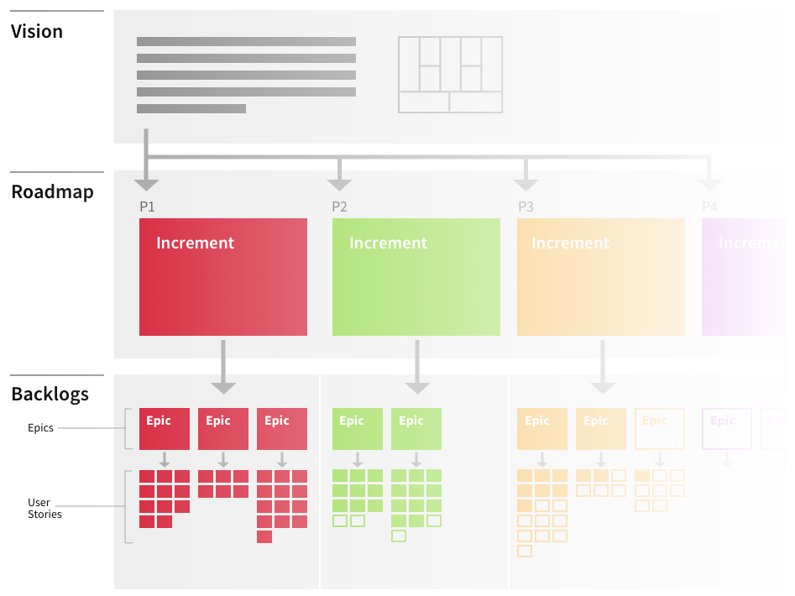
All of the work of building a product lives on a spectrum.
You need open-ended conceptual work just as much as clearly-defined execution tasks.
Conceptual
Defined

Slide 7
A Strategic Framework
Developing a strategic roadmap

Slide 8
Vision Vision statement and canvas

Slide 9
Alaska Department of Health & Social Services (DHSS) is developing a modern, integrated eligibility system that enables staff to more efficiently issue correct and timely benefits to Alaskans who need help meeting their basic needs. Utilizing agile development and modular procurements, DHSS has the goal of implementing an eligibility system that not only meets state and federal standards, but is user friendly for our clients, our eligibility staff, and our technical staff.
See on GitHub
Vision statement

Slide 10
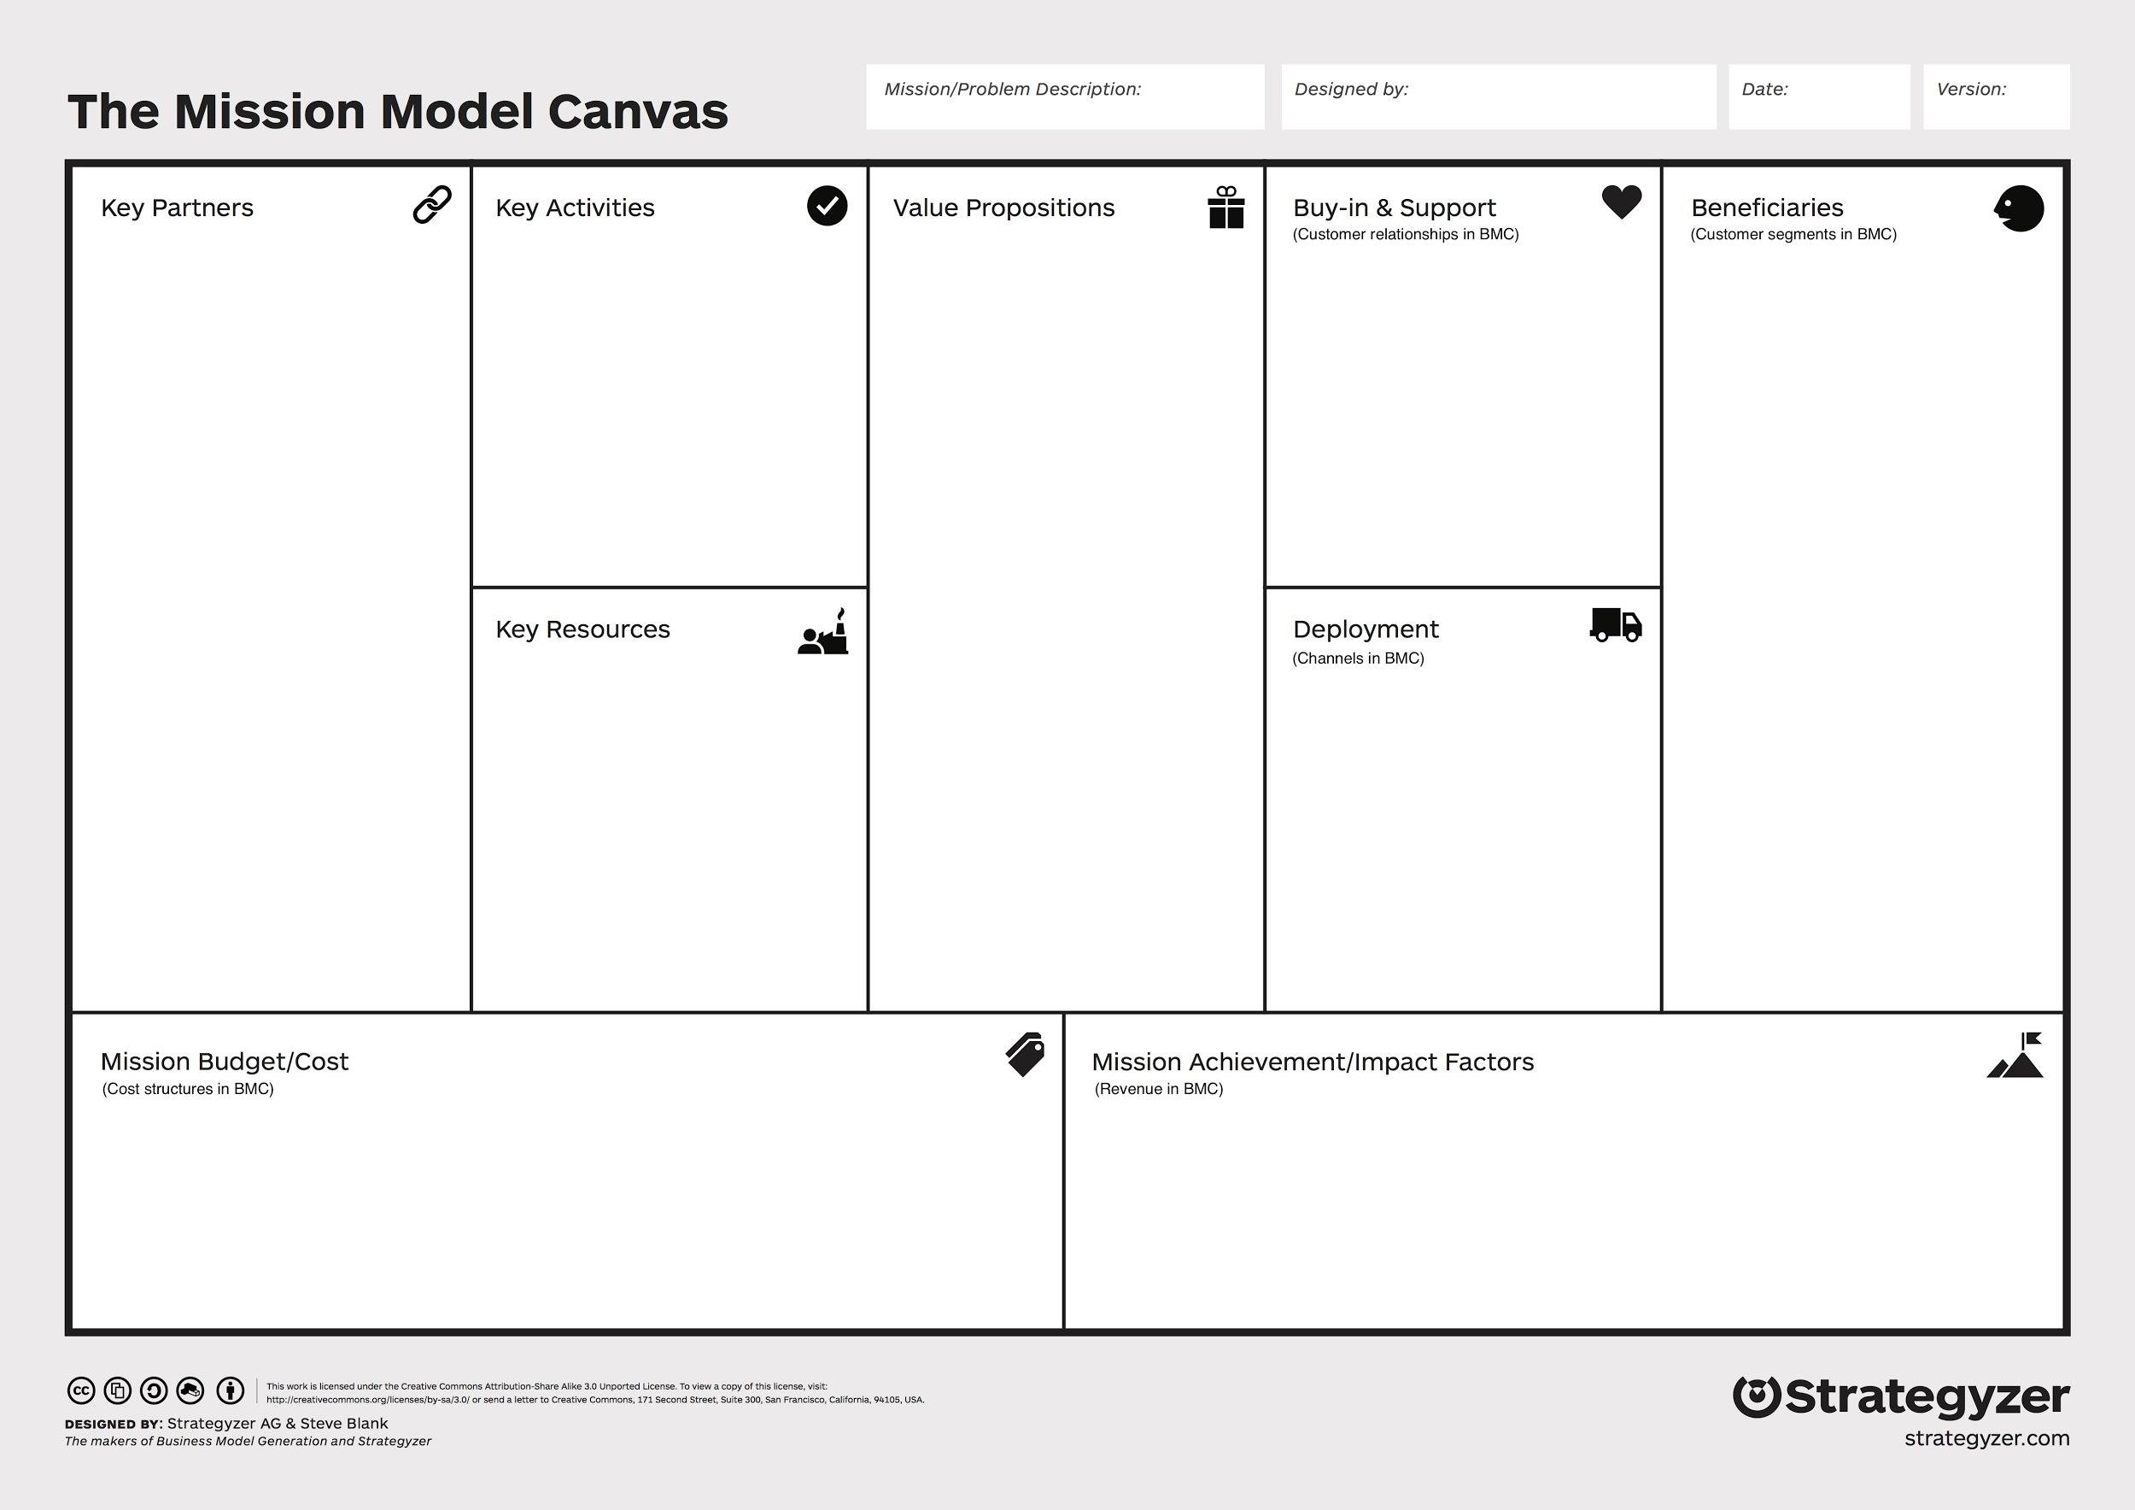
Canvas
We’re now going to build on the vision statement by visualizing the various areas of concern with respect to the overall vision.
It’s based on the Mission Model Canvas by Strategyzer http://bit.ly/2bfhfKm

Slide 11
Canvas
A winning product strategy will pay attention to these areas of concern and their relationships in order to ensure that the right thing is being delivered to the right beneficiaries.

Slide 12
Canvas
Use your strategy to inform what you work on and when.

Slide 13
Canvas
Use your strategy to inform what you work on and when.
As you consider the path forward, consult research, explore possibilities, ask questions, develop hypotheses to test, and methods of measurement

Slide 14
Canvas
Ask yourself:

Slide 15
Canvas
Ask yourself:
What is possible?

Slide 16
Canvas
Ask yourself:
What is possible?
What is sustainable?

Slide 17
Canvas
Ask yourself:
What is possible?
What is sustainable?
What already exists that we can leverage to deliver on the vision?

Slide 18
Canvas
What are the pains beneficiaries are currently experiencing?
What’s working for them?

Slide 19
Canvas
What are the pains beneficiaries are currently experiencing?
What’s working for them?
How can you best address the pains? How can you improve on things that are working?

Slide 20
Canvas
We’ve already identified some chunks of work that we can prioritize.

Slide 21
Canvas
We’ve already identified some chunks of work that we can prioritize.
We’ll use this canvas to prioritize that work, as well as anything else we want to add.

Slide 22
Canvas
From there, we’ll create a visualization of the path you will take to deliver value quickly to your highest priority beneficiaries: A product roadmap and backlog

Slide 23
The Mission Model Canvas
Developing a strategic roadmap

Slide 24
About our users, aka “beneficiaries” or customers

Slide 25
About our offering

Slide 26
About our team, work, partners and capabilities

Slide 27
Who are the users that we are serving?
What segments do they fall into?
What “jobs” do they need to get done?

Slide 28
What are we offering to them?
What are we helping them get done?

Slide 29
How do we reach each beneficiary segment?
How do we get our solutions into their hands?

Slide 30
How do we get buy-in from each beneficiary segment?

Slide 31
What is the value we create for the sum of all of the beneficiaries/the greater good?

Slide 32
What key resources underpin our mission?
Which assets are critical?

Slide 33
What activities do we need to do well to accomplish our mission?
What is critical?

Slide 34
Who do we rely on to accomplish our mission?

Slide 35
What is the resulting budget structure?
What drives our costs?

Slide 36
Now let’s work on your canvas.
https://app.mural.ly/t/gsa6/m/gsa6/1493395570501/view/3003071571
Canvas

Slide 37
Stop for now. The following will be used
for the May 8 working session.

Slide 38
Roadmap

Slide 40
We’ve worked through our vision.
And we put together a canvas to help us visualize it.

Slide 41
Now we’re going to talk about roadmapping.

Slide 42
The point of roadmaps

Slide 43
Product roadmaps are a powerful strategic tool.

Slide 44
Product roadmaps are a powerful strategic tool. They help you keep track of the big picture and correlate every work item to your end goal.

Slide 45
You shouldn’t use roadmaps to forecast exactly what will get delivered when.

Slide 46
You shouldn’t use roadmaps to forecast exactly what will get delivered when.
They’re for planning the priority order in which you’ll tackle the various pieces of the overarching problem.

Slide 47
Roadmaps are not Master Project Plans.

Slide 48
Roadmaps are not Master Project Plans.
They are designed to help us deliver the highest value to our users within the given time/budget constraints.

Slide 49
Roadmaps can and do change as you build and learn, and because the world changes.

Slide 50
Roadmaps can and do change as you build and learn, and because the world changes.
So, we cannot promise any particular feature by any particular date.

Slide 51
Pulling from your customer promises

Slide 52
Our constituent value propositions articulate the scope of the team’s work at a high level, in plain language.

Slide 53
They can be thought of as promises we make to our beneficiaries, partners and stakeholders

Slide 54
These promises serve as the backbone of the product roadmap

Slide 55
They can be broken down into smaller promises that are addressed across increments, and grouped into milestones.

Slide 56
As we iterate, we will work with the vendor(s) to break them down into smaller, more actionable chunks of work called “Epics”

Slide 57
Epics turn into the user stories and tasks that comprise the actual work in our product backlog.

Slide 58
Epics turn into the user stories and tasks that comprise the actual work in our product backlog.
We organize this work into sprints that we groom and plan with the vendor.

Slide 59
As we begin, it will be difficult to tell how long it will take for features to be completed

Slide 60
The longer we work together, and with the vendor, the better we will be able to estimate and communicate feature timelines

Slide 61
Our first step is to organize the work into milestones that make sense given our goals, and our constraints around time and budget

Slide 62
Stop for now.

Slide 63
Sequence of activities
Product Vision
Customer Promises
Iteration
User Stories
Conceptual
Defined
1.
Define vision

Slide 64
Sequence of activities
Product Vision
Customer Promises
Iteration
User Stories
Conceptual
Defined
1.
Define vision
2. Create customer promises

Slide 65
Sequence of activities
Product Vision
Customer Promises
Iteration
User Stories
Conceptual
Defined
1.
Define vision
2. Create customer promises
3. Group promises into iterations

Slide 66
Sequence of activities
Product Vision
Customer Promises
Iteration
User Stories
Conceptual
Defined
1.
Define vision
2. Create customer promises
3. Group promises into iterations
4. Prioritize
Iterations

Slide 67
Sequence of activities
Product Vision
Customer Promises
Iteration
User Stories
Conceptual
Defined
1.
Define vision
2. Create customer promises
3. Group promises into iterations
4. Prioritize
Iterations
5. Prioritize promises within iterations

Slide 68
Sequence of activities
Product Vision
Customer Promises
Iteration
User Stories
Conceptual
Defined
1.
Define vision
2. Create customer promises
3. Group promises into iterations
4. Prioritize
Iterations
5. Prioritize promises within iterations
6. Create epics and user stories to keep promises

Slide 69
Sequence of activities
Product Vision
Customer Promises
Iteration
User Stories
Conceptual
Defined
1.
Define vision
2. Create customer promises
3. Group promises into iterations
4. Prioritize
Iterations
5. Prioritize promises within iterations
6. Create epics and user stories to keep promises
7.
Prioritize epics and user stories

Slide 70
Sequence of activities
Product Vision
Customer Promises
Iteration
User Stories
Conceptual
Defined
1.
Define vision
2. Create customer promises
3. Group promises into iterations
4. Prioritize
Iterations
5. Prioritize promises within iterations
6. Create epics and user stories to keep promises
7.
Prioritize epics and user stories
8.
Groom epics and user stories

Slide 71
Customer promise 1
Customer promise 3
Customer promise 2
Iteration 1
Iteration 2
Iteration 3
Iteration 4
Epic
Epic
Epic
Epic
Epic
Epic
Epic
Epic
Epic
Epic
Epic
Epic

